Slide 1
Practice Venture NARTURE -:ONLINE NURSERY:-

Slide 2


Practice Venture
Practice Venture Name :
Name of the Institute :
Faculty Mentor Name :
NARTURE [ONLINE NURSERY]
University of Engineering & Management Kolkata
Prof. DR.Soumi Saha

Slide 3


Practice Venture Name
Product image / Company Logo

Slide 4

Basic Information
College Name : University of Engineering and Management, Kolkata
Name of Faculty/Venture Coach : Dr. Soumi Saha
Name of Regional Manager/ Global Program Manager : Prof. Subhabrata Bhattacharjee
Name of brand / company : NARTURE [ONLINE NURSERY]
URL of company profile on social media/URL of company profile on Genie
https://www.facebook.com/Narture.online -Nursery.Association/
>>Business Idea ( give a brief description )
We would setup a online store where people who need flowers for any occasions .
This website will initially contain Flower Bouquets and roses.
We will be adding items accordingto customer’s need .
Our main target customers will be for those who need flowers but can’t get easy access
Close to the heart
Y
Changes in the Ecosystem
Y
Traditional Business
Y
Clone of an Idea
N
Personal training and skills
Y
4
Practice Venture Diary 2019-2020

Slide 5
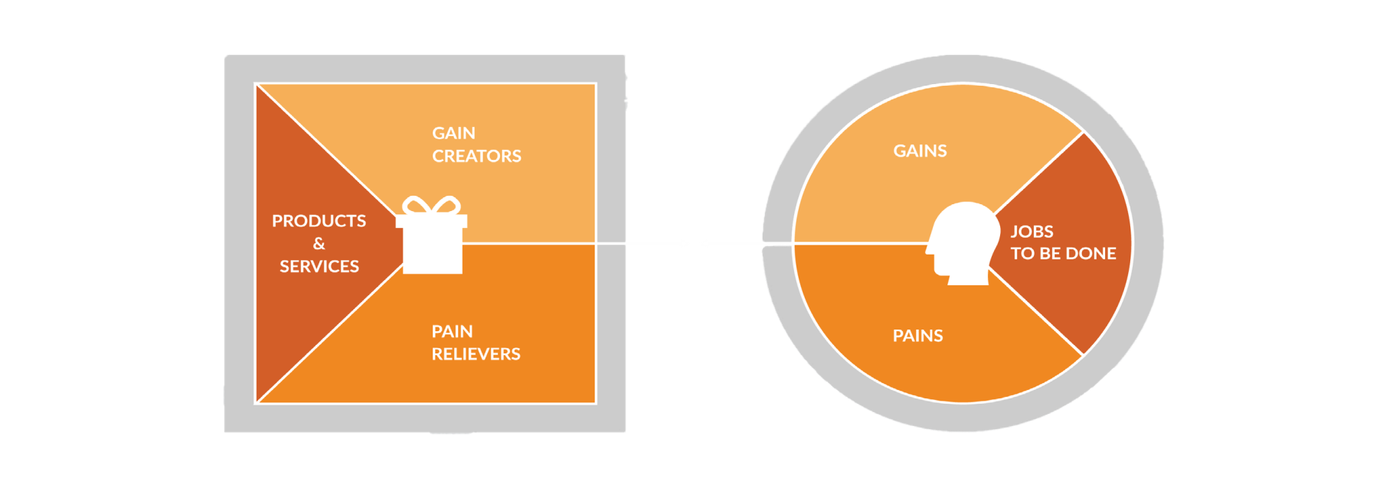
The Value Proposition Canvas
Gains
Try to freshen up those beautifull moments.
Provide fresh Bouquet that take less time to prepare, hence provide large number of customers.
Social media handles and our customers would spread the word about our set up.
Pains
We cannot be sure that everyone would like the flowers we sell.
And while increasing the no. of Bouquet we shall take time.
Solution
Once we settle down with our idea, we can hire someone to keep the stall open at the local market.
To decide what more we can sell, we can give our customers free samples to try from time to time.
8
Practice Venture Diary 2019-2020

Slide 6
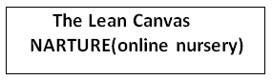
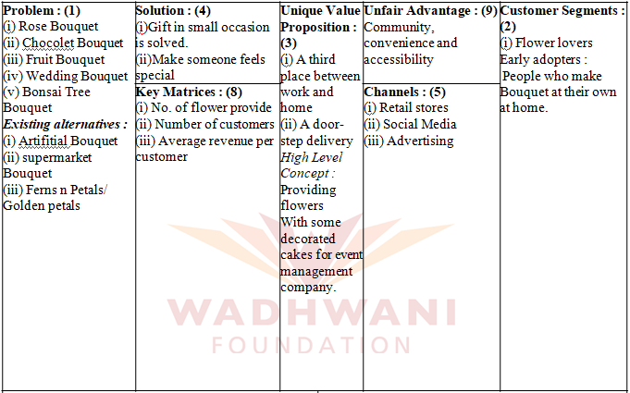
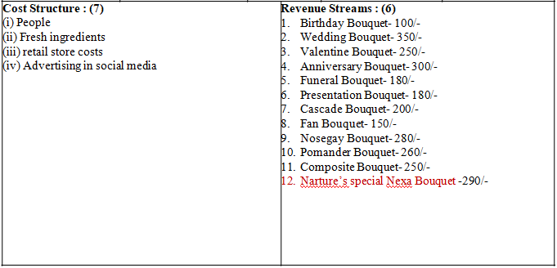
16
Practice Venture Diary 2019-2020

Slide 7
Getting Your MVP Ready & Testing It
Contact Information
Name : Anirban Singhaniya
Age : 34
Email : anirbansinghaniya001@gmail.com
Phone no. : 8013721303
Your Problem
Problem 1
Flower should not be damaged while carrying it to deliver.
Problem 2
Decorative part of the Bouquet should be bit more delicious.
Problem 3
Packaging should be bit more attractive and secure.
Payment
Amount to pay : 250/- per bouquet
Referrals
B.K Sen Saroni lane Nagerbajar,kolkata 700130,
Anubrata Ghosh
Follow us on facebook (Nerture Association)
17

Slide 8

Wadhwani Foundation
Tower - 3, 6th Floor, SJR I Park, EPIP Zone -1, Whitefield, Bangalore - 560066

